Slide 1

Apache Kafka Basics
Mateusz Dymiński

Slide 2
Kafka Basics Agenda
What’s Apache Kafka
Basic concepts
Features of Kafka

Slide 3
What is Kafka?
Kafka is a messaging system that is designed to be fast, scalable, and durable.
It is an open-source stream processing platform.
Originated at LinkedIn and later became an open-source Apache project in 2011
Kafka is written in Scala and Java.
It aims at providing a high-throughput, low-latency platform for handling real-time data feeds.

Slide 4
What is Kafka?
Apache describes Kafka as a distributed streaming platform that lets us:
Publish and subscribe to streams of records.
Store streams of records in a fault-tolerant way.
Process streams of records as they occur.

Slide 5

Kafka concepts

Slide 6
Records
Records = message = event
Each record consists of a key, a value, and a timestamp.
Categorized into Topics
Message = byte array
Serializer is not necessary

Slide 7
Topics and Logs

Slide 8
Partitions

Slide 9
Partition Offset

Slide 10
Replicas

Slide 11
Brokers

Slide 12
Cluster

Slide 13
Zookeeper

Slide 14

Kafka Features

Slide 15
Multi Tenancy
You can deploy Kafka as a multi-tenant solution.
Multi-tenancy is enabled by configuring which topics can produce or consume data
Support for quotas - administrators can define quotas to control the broker resources that are used by clients.

Slide 16
Geo Replication
Kafka MirrorMaker provides geo-replication support.
messages are replicated across multiple datacenters or cloud regions
active/passive scenarios for backup and recovery;
active/active scenarios to place data closer to your users

Slide 17
Guarantees
At a high-level Kafka gives the following guarantees:
Messages sent by a producer to a particular topic partition will be appended in the order they are sent
Consumer sees records in the order they are stored in the log.
Topic with replication factor N, we will tolerate up to N-1 server failures.

Slide 18
Kafka as Storage System

Slide 19
Retention

Slide 20
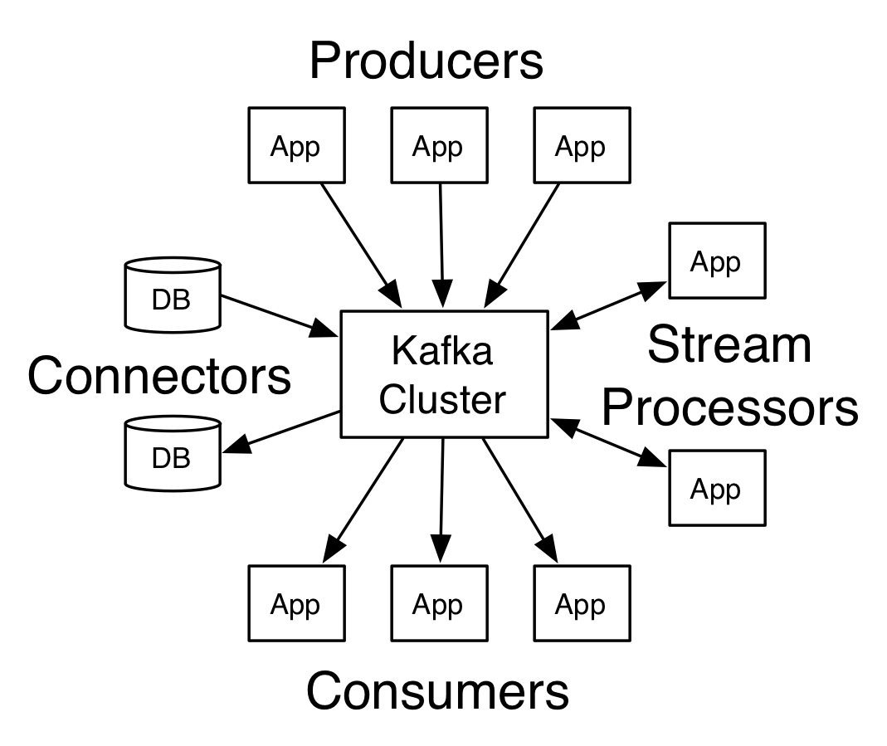
Kafka API

Slide 21
Producer API
The Producer API allows an application to publish a stream of records to one or more Kafka topics.

Slide 22
Consumer API
The Consumer API allows an application to subscribe to one or more topics and process the stream of records produced to them.

Slide 23
Streams API
The Streams API allows an application to act as a stream processor, consuming an input stream from one or more topics and producing an output stream to one or more output topics, effectively transforming the input streams to output streams.

Slide 24
Connector API
The Connector API allows building and running reusable producers or consumers that connect Kafka topics to existing applications or data systems. For example, a connector to a relational database might capture every change to a table.

